Slide 1

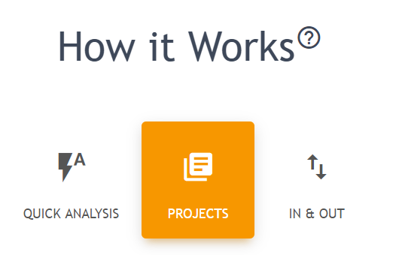
MetSolution tutorial
Aug 29th 2019

Slide 2
Simply pick either one of
1 QUICK ANALYSIS
2 PROJECTS
3 IN & OUT
QUICK ANALYSIS is for applying a statistical pipeline (used for another project) to a new project.
PROJECTS is for performing a sequence of statistical analyses on an uploaded dataset.
IN & OUT is for performing a single statistical analysis on a dataset.

Slide 3

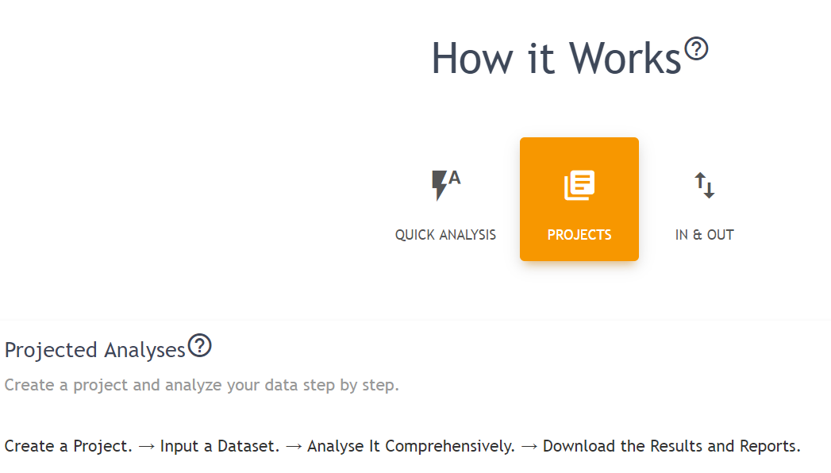

See individual
for more information.

Slide 4
Thank you!
If any question/suggestion/collaboration, please feel free to contact slfan@ucdavis.edu
Official version will be submit on October 2019.

